Slide 1
FINAL WORKSHOP
I3S – Implementing and sharing statistical services
27-28 April 2021
I3S - Implementing and sharing statistical services
Communication

Slide 2
Notes:
As we all noticed there are far more statistical services devélopers

Slide 3
Notes:
than reusers in the ESS

Slide 4
Notes:
At a glance this is a strange phenomenon taking into account that developing a new service has higher costs,

Slide 5
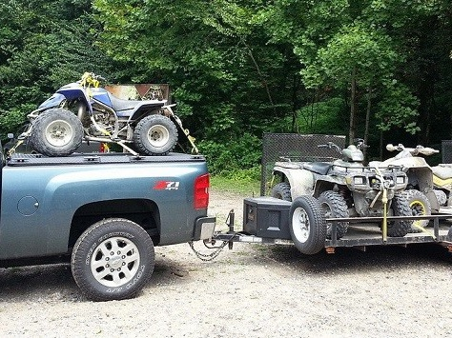
Notes:
,requires more resources,

Slide 6
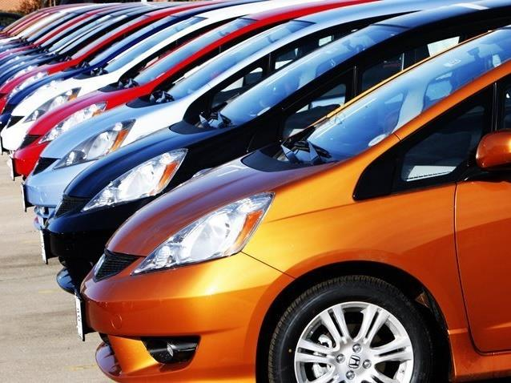
Notes:
and there is a high level of similarity among the statistical services

Slide 7
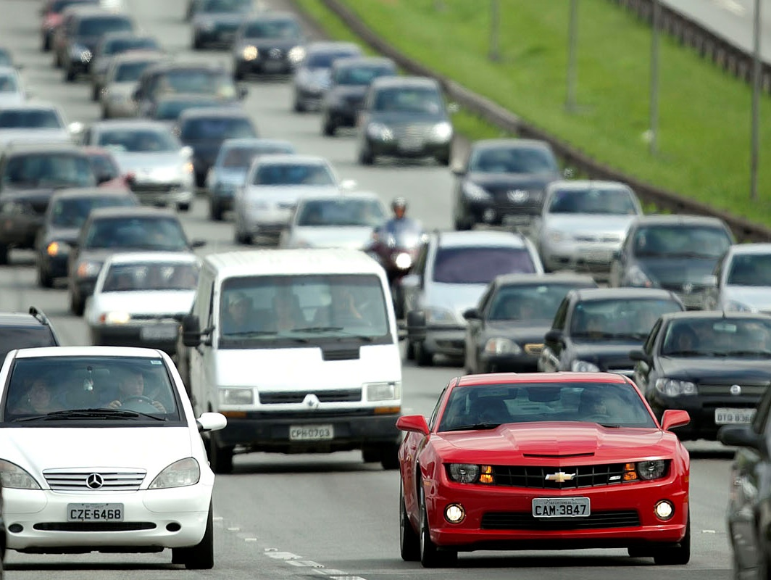
Notes:
that, in principle, have to perform analogous statistical functions.

Slide 8
Notes:
Very often, the will to share and reuse a software component or a service, is clearly expressed,

Slide 9
Notes:
but it is difficult to concretely do it.

Slide 10
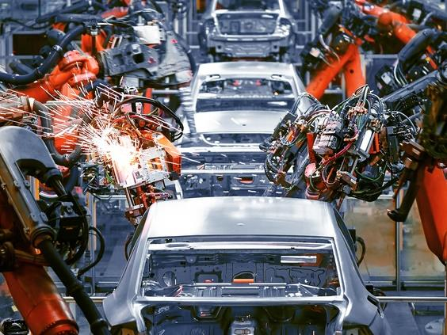
Notes:
ESSnet on “Implementing Shared Statistical Services” devotes not only to developing these services

Slide 11
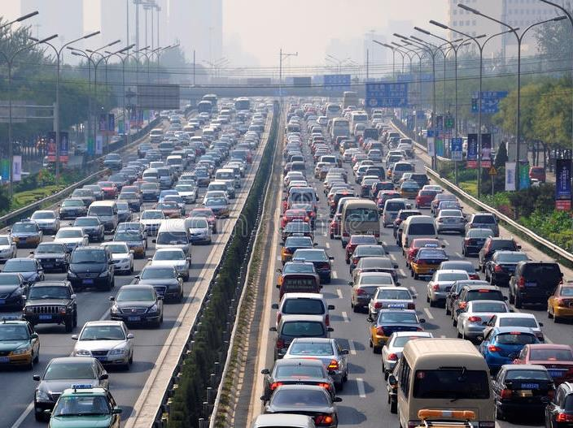
Notes:
but also to enhancing shared services reuse.

Slide 12
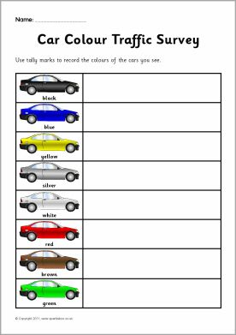
Notes:
The first objective of this workpackage was to conduct a survey

Slide 13
Notes:
to understand what can be the incentives for sharing and reusing,

Slide 14
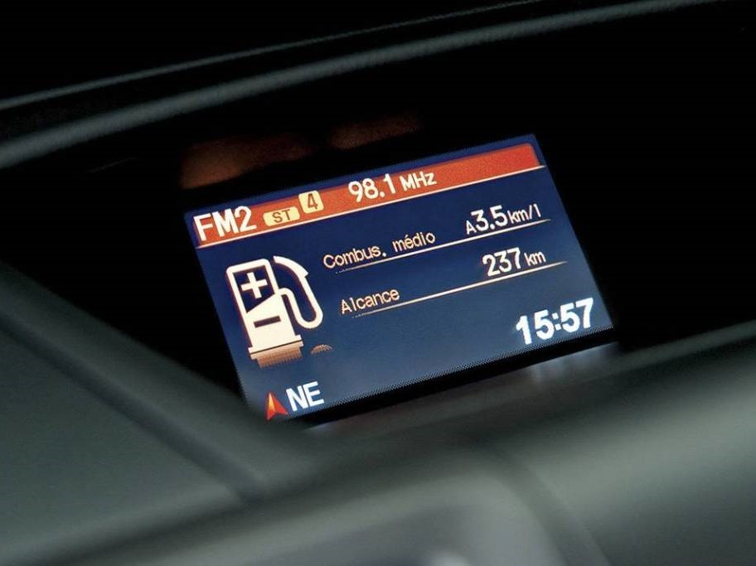
Notes:
what are the elements used for evaluating such a decision,

Slide 15
Notes:
but also, what are the barriers which can hinder a statistical institute to reach successfully the end of the process.

Slide 16
Notes:
The survey aims to perceive the experience from the two different points of view of the service development and use.

Slide 17
Notes:
First as a developer (source) does the NSI share their services ?

Slide 18
Notes:
and is it able to convince the community to use them?

Slide 19
Notes:
Secondly as a reuser (receiver) does the NSI reuse shared services ?

Slide 20
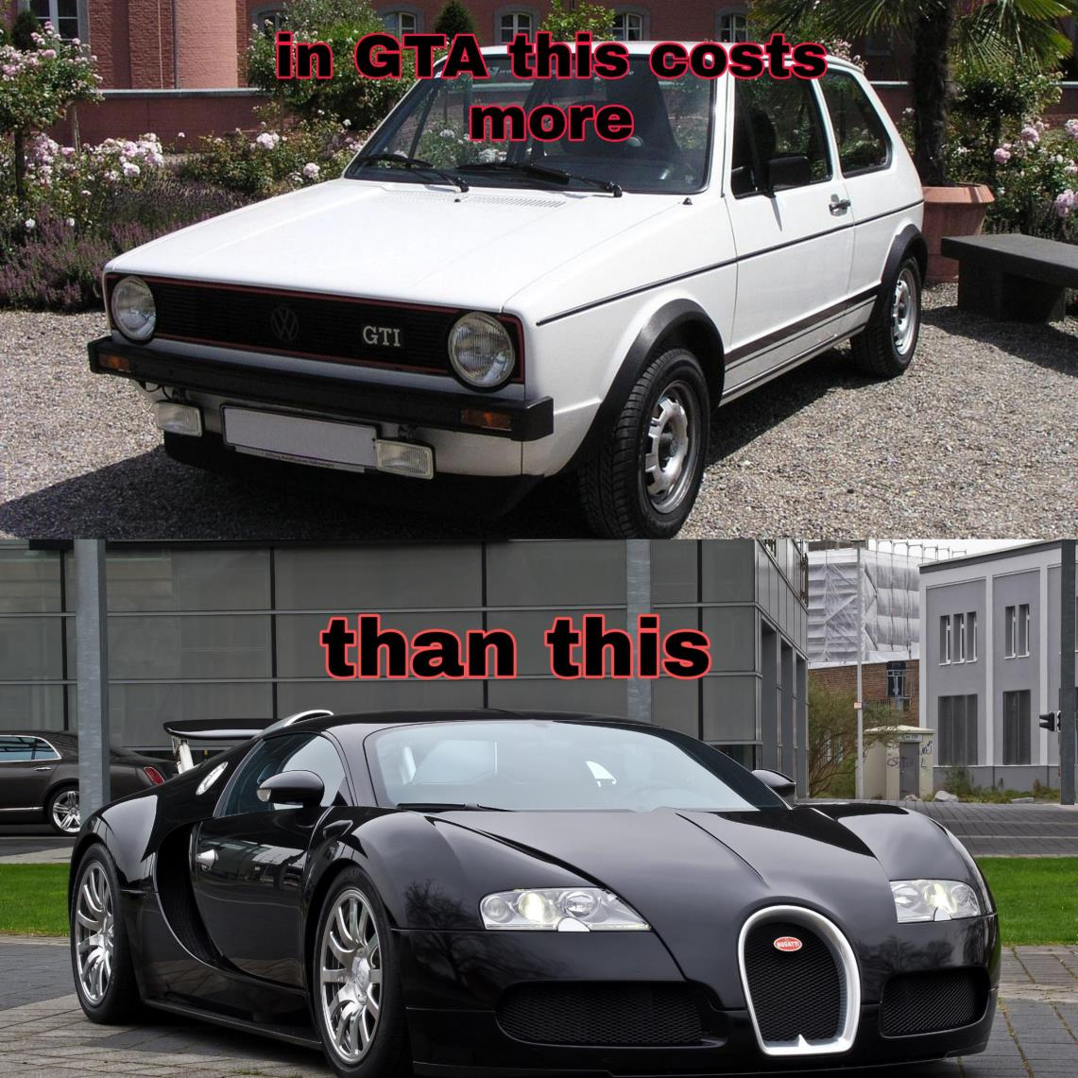
Notes:
and what is the drive for that reuse.

Slide 21
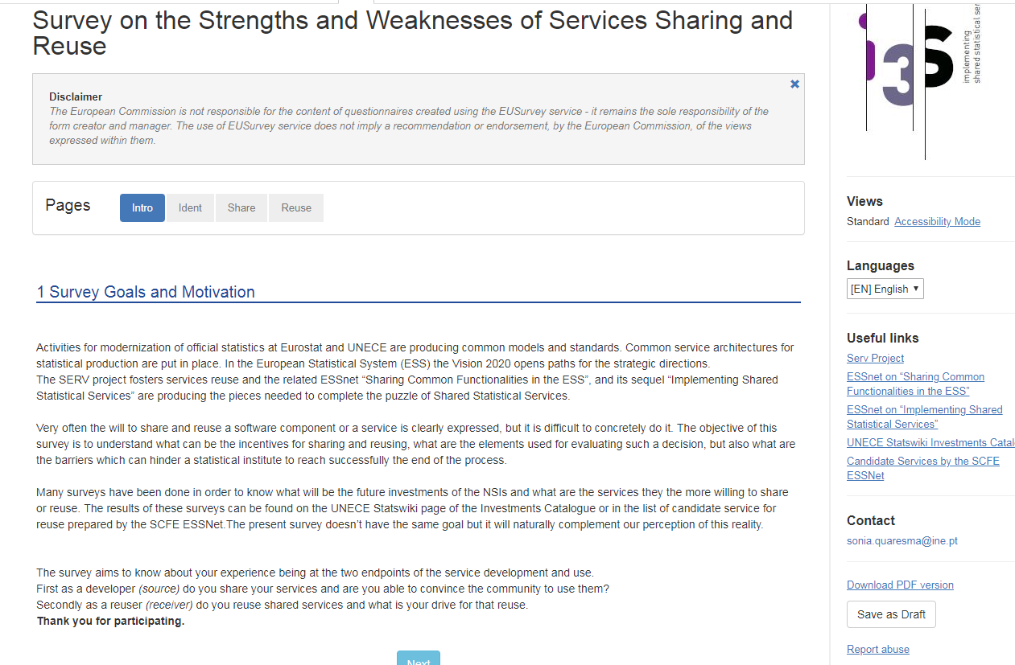
FINAL WORKSHOP
I3S – Implementing and sharing statistical services
Notes:
The survey was open for answers by all partners from 18 November until 18 December 2019

Slide 22
FINAL WORKSHOP
I3S – Implementing and sharing statistical services
Notes:
And we used the EUServey service. A successful reuse of a service

Slide 23
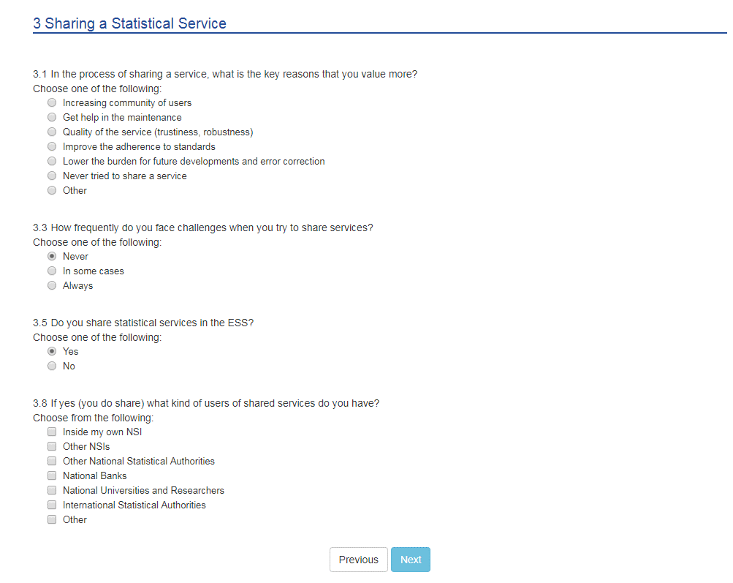
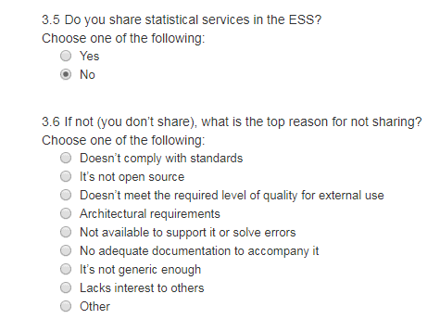
FINAL WORKSHOP
I3S – Implementing and sharing statistical services
Notes:
With Questions for those who share or intend to share services

Slide 24
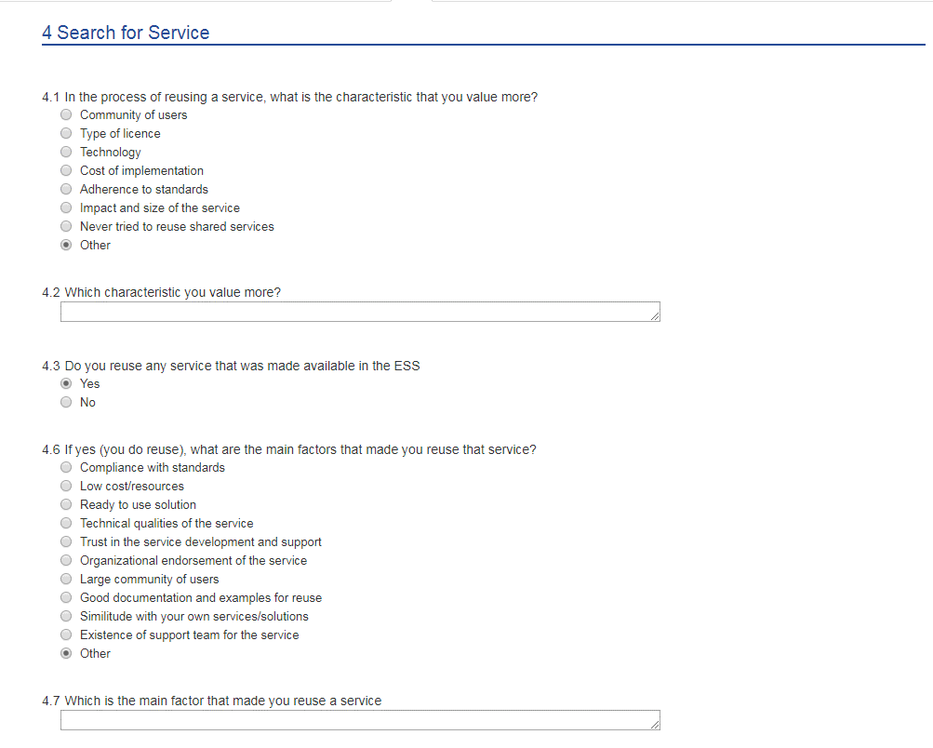
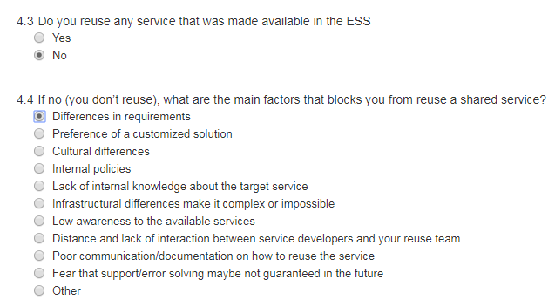
FINAL WORKSHOP
I3S – Implementing and sharing statistical services
Notes:
And Questions for those who reuse or want to reuse services

Slide 25
FINAL WORKSHOP
I3S – Implementing and sharing statistical services
Notes:
So, what were the Survey results?

Slide 26
FINAL WORKSHOP
I3S – Implementing and sharing statistical services
Not all countries answered the survey despite we did two attempts
Difficulty to identify the community of managers
Notes:
Globbaly, the fist obervation is that

Slide 27
FINAL WORKSHOP
I3S – Implementing and sharing statistical services
58,8% said that they reuse statistical services
41,2% said that they share statistical services
Observing the answers of each country, and knowing their status in term of reuse and share services we conclude that:
Managers are not aware that they are sharing or reusing tools
There are some confusion on the concepts of reuse or share services

Slide 28
FINAL WORKSHOP
I3S – Implementing and sharing statistical services
In the process of sharing a service, what are the key reasons that you value more?
Lower the burden for future developments and error correction
Quality of the service (trustiness, robustness)
47%
24%
12%
12%
6%
Increasing community of users
Other: Allow for others to benefit from the service
Never tried to share a service
Notes:
These 3 reasons are very important for the ones who are willing to share. In this Essnet we experienced the benefit
from sharing a service that allowed other perspectives that improved the original service

Slide 29
FINAL WORKSHOP
I3S – Implementing and sharing statistical services
How frequently do you face challenges when you try to share services? Can you provide an example?
During the implementation of Jdemetra+ in our institution we have to face challenges regarding documentation, plug-in the software with other pieces of internal processes and so on
When we use software packages developed by Eurostat
Commitment from management, security demands, worries about future demands
54%
Loading cubes into the Sdmx Reference infrastructure
Different use cases need different solutions. New users use a tool in a way it was never intended to be used , etc.
Merging statistics and other interesting data with spatial units
In some cases

Slide 30
FINAL WORKSHOP
I3S – Implementing and sharing statistical services
How frequently do you face challenges when you try to share services?
the claimed uniqueness of each individual stovepipe process makes it hard to convince to use an already existing service instead of program one yourself.
When sharing, there is always organizational challenges. Another challenge, mainly for the reuser, is to comply with the standard implemented by the tool. And technical challenges (open-source...)
Challenges in defining common data structures to describe services inputs and outputs
23%
Always

Slide 31
FINAL WORKSHOP
I3S – Implementing and sharing statistical services
If not, what is the top reason for not sharing?
40%
Not available to support it or solve errors
Don’t share
58,8%
20%
It’s not generic enough
20%
%
It’s not open source
10%
10%
Doesn’t comply with standards
Other: We don't produce services

Slide 32
FINAL WORKSHOP
I3S – Implementing and sharing statistical services
If not, what is the top reason for not sharing?
Doesn’t meet the required level of quality for external use
Architectural requirements
No adequate documentation to accompany it
Lack interest of others

Slide 33
FINAL WORKSHOP
I3S – Implementing and sharing statistical services
In the process of reusing a service, what is the characteristic that you value more?
41%
Cost of implementation
Never tried to reuse shared services
24%
12%
12%
6%
Impact and size of the service
Community of users
Adherence to standards
6%
Other (Impact, best value for money)
Notes:
The majority referred Adherence to standards as a characteristic that they value more witch is very important and a scope in this Essnet

Slide 34
FINAL WORKSHOP
I3S – Implementing and sharing statistical services
If no, what are the main factors that blocks you from reuse a shared service?
28,5%
Infrastructural differences make it complex or impossible
Don’t reuse
41,2%
28,5%
Low awareness to the available services
14,3%
14,3%
Lack of internal knowledge about the target service
Other (Several: Differences in requirements, Lack of internal knowledge about the target services; Infraestructural differences make it complex or impossible; Fear that support/error solving maybe not guaranteed in the future )
14,3%
Fear that support/error solving maybe not guaranteed in the future
Notes:
We could cope with this problems in this work package

Slide 35
FINAL WORKSHOP
I3S – Implementing and sharing statistical services
If no, what are the main factors that blocks you from reuse a shared service?
Preference of a customized solution
Cultural differences
Internal policies
Distance and lack of interaction between service developers and your reuse team
Poor communication/documentation on how to reuse the service

Slide 36
FINAL WORKSHOP
I3S – Implementing and sharing statistical services
If yes, what are the main factors that made you reuse that service?
40%
Compliance with standards
Reuse
58,2%
Good documentation and examples for reuse
30%
10%
Low cost/resources
10%
10%
Trust in the service development and support
Large community of users

Slide 37
FINAL WORKSHOP
I3S – Implementing and sharing statistical services
If yes, what are the main factors that made you reuse that service?
Ready to use solution
Technical qualities of the service
Organization endorsement of the service
Similitude with your own services/solutions
Existence of support team for the service

Slide 38
FINAL WORKSHOP
I3S – Implementing and sharing statistical services
Some conclusions:
50% don’t share services because they are not generic enough, not open source or don’t comply with standards
40% reuse services because they are compliance with standards
43% don’t reuse services because they don’t know much about them

Slide 39
Notes:
One problem detected is the low awareness of the available services. We hope to overcome this with the work described
in deliverable D.4

Slide 40
SINDER
Notes:
And one tool to overcome this, could be with the development of an application like Sinder.

Slide 41
Notes:
Although a catalog already exists is not much publicized or not friendly enough

Slide 42
SINDER
Notes:
The sinder will have information that is already in the catalog

Slide 43
Notes:
that is more enjoyable and

Slide 44
Notes:
user friendly to increase the use of this information and thus generalize the reuse of services

Slide 45
Notes:
Sinder will be a binary tree

Slide 46
Notes:
And The idea is that the users answer simple questions with yes/no (left/right),

Slide 47
Notes:
which narrows the hypotheses

Slide 48
Notes:
shows them the available services that meet those criteria.

Slide 49
Notes:
In the event that no service exists that meets exactly that criteria, other similar services should be presented.

Slide 50
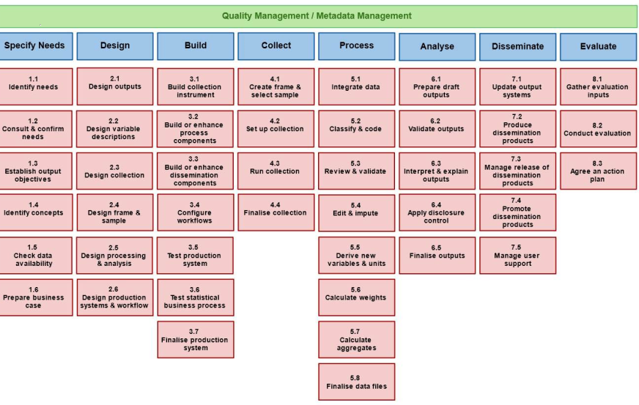
Notes:
Because GSBPM processes are already rather familiar to users from NSIs, it will be the starting point of the decision tree:
For example if we choose Sub-process 6.3 – interpret and explore outputs

Slide 51
FINAL WORKSHOP
I3S – Implementing and sharing statistical services
SINDER
Seasonal Adjustment
Yes
Do you accept Proprietary?
Yes
Yes
JAVA?
No
Computing indexes
Yes
Do you accept not RESTfull
Prepare maps
Yes
Method 1
No
You should try JDEMETRA+!
Yes
Method 2
No
You should try Chart Generator
Sorry. We don’t have that service
Notes:
And then go deciding

Slide 52
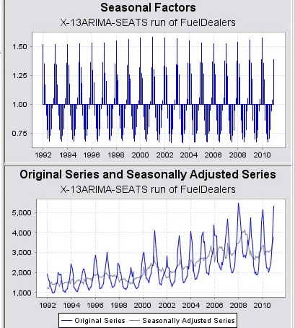
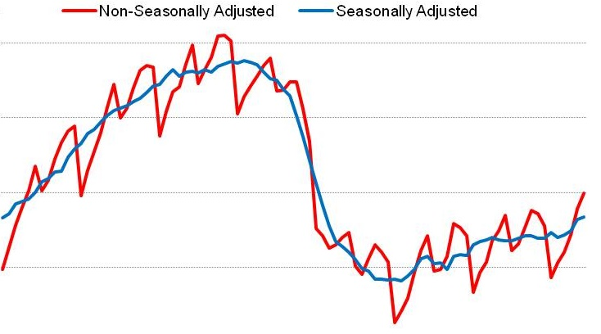
YOU SHOULD TRY
SEASONAL ADJUSTMENT?
JAVA?
X-13ARIMA-SEATS METHOD?
ACCEPT PROPRIETARY?
JDEMETRA+
Notes:
By move to the right (yes) or left (no)
--
We arrived on a match on a service

Slide 53
COMPUTING INDEXES?
SEASONAL ADJUSTMENT?
SORRY. WE DON’T HAVE THAT SERVICE
Notes:
Or if we choose other hypotesis

Slide 54
Notes:
Some specifications were defines

Slide 55
Notes:
The first is that is that the Sinder will be based on the Catalog information

Slide 56
Notes:
GSBPM is the starting point

Slide 57
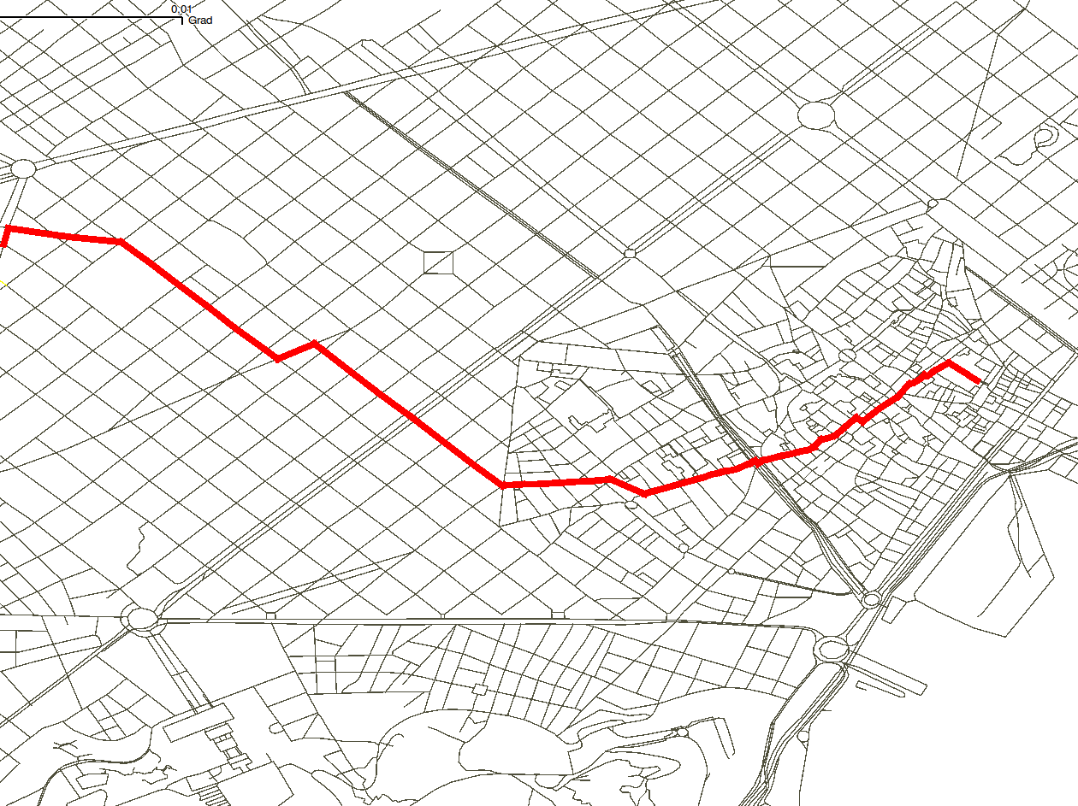
Notes:
When navigating Sinder, the shortest path should be calculated

Slide 58
Notes:
When a service is matched, all their characteristics should be displayed

Slide 59
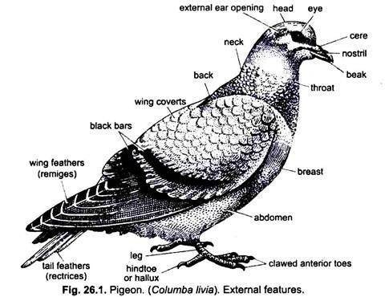
Notes:
When a service is not matched, a similar service could be presented with their characteristics

Slide 60
Functions
Contrainsts
Objectives
Softwares used
Keywords
…
Methods
Notes:
The catalog will need more fields like function, objectives, keywords,
software used, methods, constraints, etc. to allow Sinder to be more interactive

Slide 61
Further information filled by servise owners
Notes:
The catalog needs to be further completed and users that fill information regarding their services should enter as much characteristics as possible
There are more information on this in the deliverables

Slide 62
Notes:
Another objective of this wp was to comunicate sucess stories and provide a cummunication kit

Slide 63
Notes:
Due to the technological developments of the last decade, It would be easy to assume that by now a huge number of statistical services would be reused by the statistical community.

Slide 64
Notes:
Barriers to service sharing have been overcome with encapsulation, for example,

Slide 65
Notes:
and even the cultural transition of software as a service has been made by the NSIs.

Slide 66
Notes:
So why is the number of services being reused so low?

Slide 67
Notes:
For some time now this issue has been discussed in different meetings of the statistical community,

Slide 68
Notes:
and several ways of better promoting the reusability of services have been proposed.

Slide 69
Notes:
Primarily what is necessary is to disseminate the information of services availability to the community.

Slide 70
Notes:
From a business management perspective,

Slide 71
Notes:
the sole existence of a catalogue is not able to perform the most important functions of advertisement like

Slide 72
Notes:
identifying the audience

Slide 73
Notes:
establishing recognition of the service being presented,

Slide 74
Notes:
and motivating the distributors.

Slide 75
Notes:
Nonetheless throughout the years there have been successful cases of services/software that are widely reused within the ESS.

Slide 76
Notes:
By examining those closely we hoped to

Slide 77
Notes:
distil the success formula that will allow us to increment the number of services being reused.

Slide 78
Notes:
We focused on the success stories that exist,

Slide 79
Notes:
trying to understand them

Slide 80
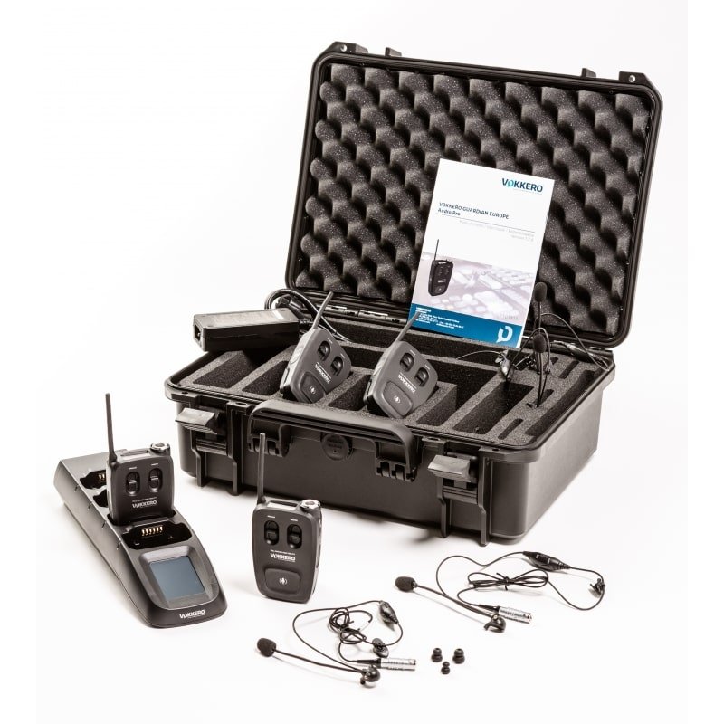
Notes:
finally developing an adequate way to communicate the shared services availability to the statistical community.

Slide 81
Source
Message
Channel
Receiver
Feedback
Environment
Context
Interference
Notes:
There Some key concepts that must be considered:

Slide 82
Notes:
Who is the source?
The message will be different depending on the source that advertise the service.

Slide 83
Notes:
For example, if an IT developer is the source

Slide 84
Notes:
its receiver should not be domain experts, even if they are the ones who will benefit by the adoption of the service.
A manager will also probably be unable to decide based on the technical description, even if accurate, provided by IT developers.

Slide 85
Notes:
A manager would decide if he can endorse the reuse of a service or develop something from scratch customized for his needs based on more high-level information about the service.

Slide 86
Notes:
To advertise success stories or service advertisement some channels can be used like
Flyers, Posters, Videos, WebPages, Information documents or Interviews. Some examples will be provided.
The message must also be adapted depending on the channel used.

Slide 87
Notes:
The communication of a service or list of services tends to be unidirectional therefore there is often no way for the recipients to provide feedback.
This also hinders the trust of the potential reusers as the feeling of community behind a statistical service is not lost.

Slide 88
Notes:
To enhance and focus the communication of services, three types of receivers should be considered since all of them have different perspectives about sharing or reusing services:

Slide 89
Notes:
Managers;

Slide 90
Notes:
Subject specialists;

Slide 91
Notes:
And IT persons.

Slide 92
Notes:
Management receivers will probably be reached over more generic conferences targeting modernization for example,

Slide 93
Notes:
while domain specialists will perhaps be more enthusiastic about a service reuse after a demo by its peers in other NSI.

Slide 94
Notes:
The message may/must be different for each group of receivers

Slide 95
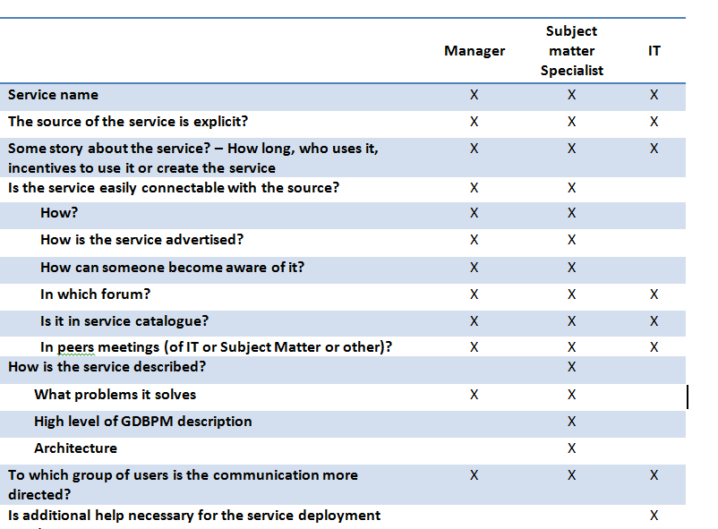
In communication, defining the target is very important because different target should get different messages
Notes:
and for each group the proper guidelines must be found:

Slide 96
Notes:
Flyers might not be as trendy as they once were, but that does not mean they are not effective.

Slide 97
Notes:
In the digital age, most companies focus on an exclusively digital strategy.

Slide 98
Notes:
But because people are so inundated with emails, ads, and information (a lot of which is irrelevant), they can be wary of information they get online.

Slide 99
Notes:
Print mediums also come with a sense of authority and legitimacy.

Slide 100
Notes:
Flyers also give the opportunity to capture people where they already are and deliver the most relevant information at the most relevant time.

Slide 101
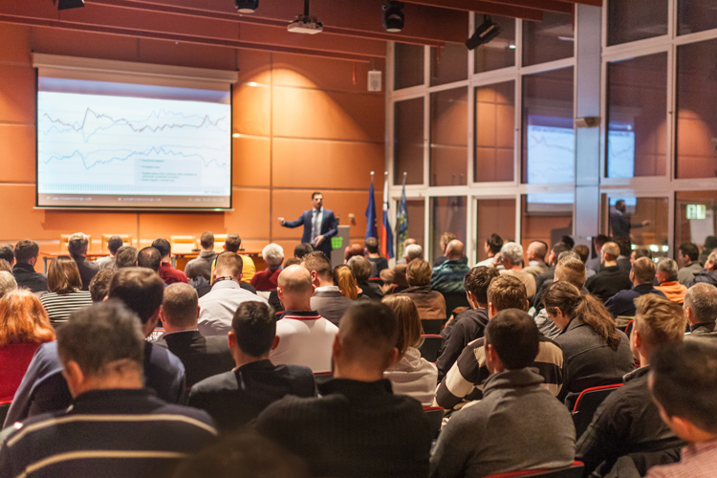
Notes:
For example, if the flyer is advertising an upcoming service, it could be delivered out at a conference where it is known the managers or
subject matter persons that are the target audience will be present.

Slide 102
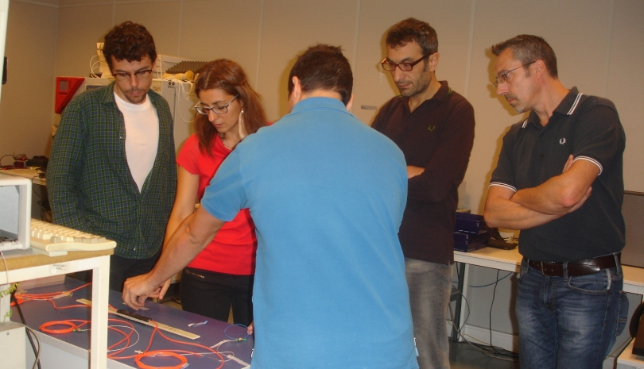
Notes:
If the flyer is more focused on IT people, it could be distributed at a more technical workshop.

Slide 103
Notes:
The point is, passing out flyers might not be as simple as clicking the mouse, but it does allow to capture the audience when they are most likely to be open to hearing the message, and that is worth the extra effort.

Slide 104
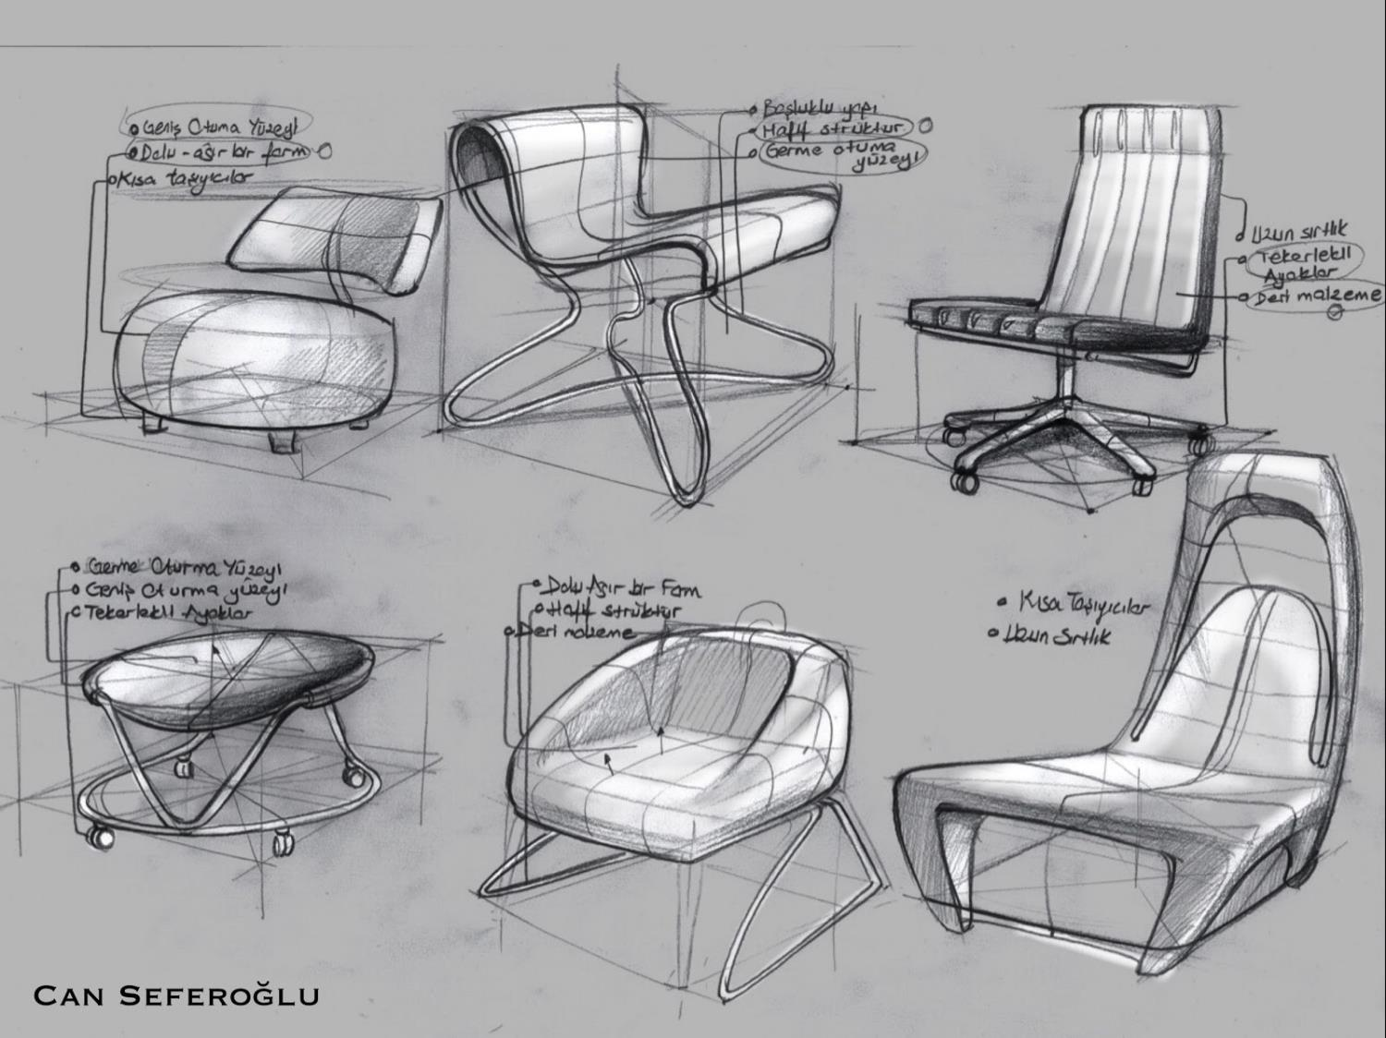
Notes:
There are a few design and concepts elements every flyer needs to make an impact

Slide 105
Notes:
Please read deliverable 4.2 if you want to learn more

Slide 106
FINAL WORKSHOP
I3S – Implementing and sharing statistical services
Header with logo, and possibly the receiver (What is the name of the service ? Who is the source of the service ?)
Service description: history (How long has it been used ? Is it used in other NSIs ? What have been the incentives to develop and use this service ?), functionalities (Which problem is solved ?), architecture (Is it possible to relate to the GSBPM ?)
Conditions of using
Documentation and additional resources, link to the Catalogue (What is the channel to obtain the service ? Is a manual available ? Is there any help desk ? What is the level of technical support ? Is there any support for day to day operation ? Is there some tool/demo app to evaluate/try the service ?)
Future development
License
Contact (Does the possibility to provide feedbacks on the service exist ? Is there a user group? Is it possible to contribute to the development of the service ?)
Notes:
A template for service advertisement flyer was suggested:

Slide 107
Notes:
Based on these concepts and templates some flyers were developed.
This one for JDemetra

Slide 108
Notes:
PxWeb – For managers

Slide 109
Notes:
PxWeb – For IT specialists

Slide 110
Notes:
ARC

Slide 111
Notes:
RELAIS for managers

Slide 112
Notes:
RELAIS for subject matters

Slide 113
Notes:
Videos are another effective way to communicate and advertise available services. There are 5 steps to follow

Slide 114
Notes:
Step 1. Determine the purpose of the video.
“why” behind the video. In other words, what is the end goal? What are the objectives with this video?

Slide 115
Notes:
Step 2. Define the type of video to create
The type of video to create will play a role in its success as well, as video format should be produced in a format that makes sense for the goal and target audience.
Some examples of common types of videos and their related uses include:
Product focused:
Explanatory:
Problem-solving:
Creative:

Slide 116
Notes:
. Choose a video style
There are many video styles to choose from, including:
Live-action
Animation
Whiteboard videos
Motion graphics videos
Live stream
Photomontage
Screencast videos
Typography videos

Slide 117
Notes:
. Step 4. Write the script
The script serves as the message to be communicated in the promo video.

Slide 118
Notes:
Step 5. Video production
The creation of a video can be divided into three phases: pre-production, filming, and editing.

Slide 119
Notes:
Again, for more information read deliverable 4.2 if you want to learn more

Slide 120
It can be viewed in: https://www.youtube.com/watch?v=zeiefI85EVo

Slide 121
Notes:
Conclusions

Slide 122
Notes:
As stated Enhancing the reuse of services is a main concern in the statistical office’s community.

Slide 123
Notes:
The development of an adequate communication policy in services advertisement should be a main concern as it will decide on its future reuse or not.

Slide 124
Notes:
The current work tries to shed some light into the process of communicating the availability of a service.

Slide 125
Notes:
, it was envisaged to provide some guidelines for the future production of communication elements
that must accompany every sharable service developed.

Slide 126
Notes:
We all can conclude that communicate more about a product make us be more familiarized with it

Slide 127
Notes:
questions

